Slide 1

TERI Stakeholder Meeting
Anya Boyd
Energy Research Centre
University of Cape Town
11 August 2011

Slide 2
Overview
SA Climate & Energy Policy
SA Mitigation
Unpacking & implementing NAMA’s
Other related work on NAMA’s

Slide 3
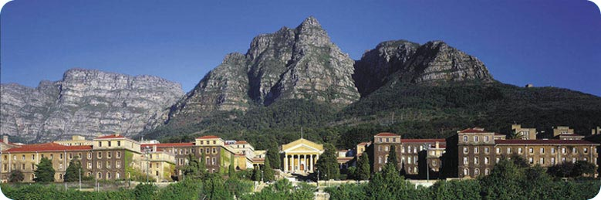
Energy Research Centre
4 Different Groups
  Energy Environment & Climate Change
  Energy efficiency
  Energy modeling
  Energy Poverty & Development
E.g. Academic, NGO, government

Slide 4
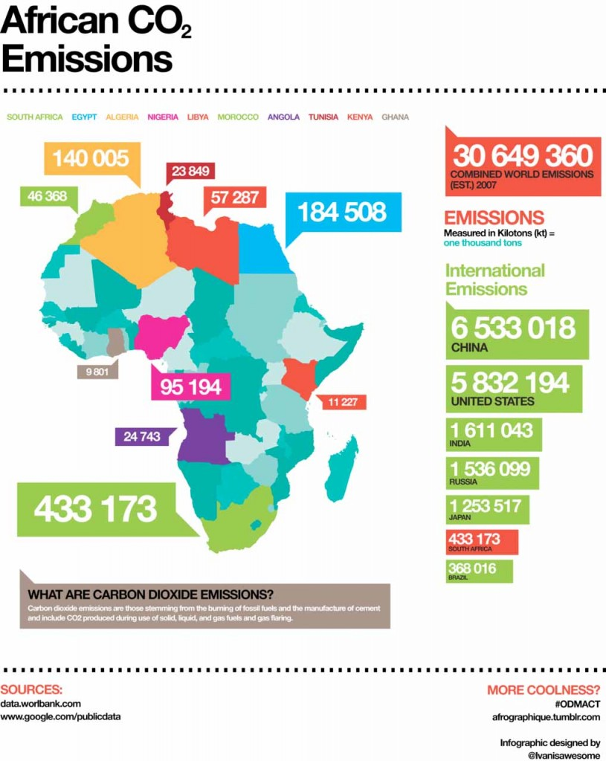

Slide 5
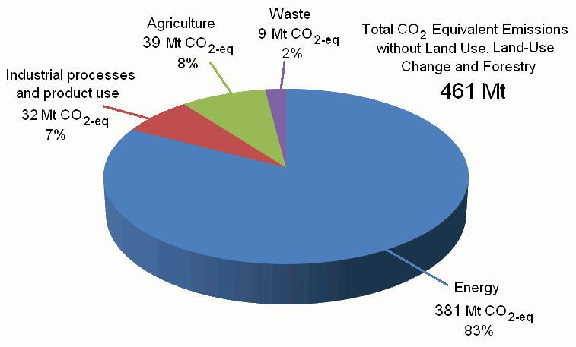
SA Emissions profile
2000 GHG Inventory

Slide 6


SA highest CO₂ emissions in African continent 96.2 Mt Ce (2007)
1.19% of global CO₂ emissions, but high energy intensity makes it 44th (out of 185 countries) per capita emissions (CAIT 2011)
Reliance on coal – high energy intensity of the economy, 20th in the world (CAIT 2011)
Coal provides 77% of primary energy needs (Eskom 2011) including 93% of electricity generation (IEA 2010)

Slide 7


Climate/energy policy context
National Climate Change Response (NCCR)- DEA
  Green Paper 2010 to White Paper
REFIT-’re-bid’ recently increased - DoE
Carbon Tax discussion paper - NT
Industrial Policy Action Plan (IPAP) DTI
  South African Renewable Initiative (SARi)
Integrated Resource Plan (IRP) – electricity generation – DoE – gazetted May 2011
Renewable Energy White Paper 2003 – 10, 000Gwh 2013
National Planning Commission (NPC) – Low Carbon Economy
Notes:
It was a subsection of energy policy – 2 yrs after being released, treasury then decided wasn’t in alignment with gov procurement policy, re released – now based on price competetiveness, not price – ask INDIA . Not inline with the IRP – Refit
IPAP 2010 – first time Green economy/RE mentioned in Ind policy – very vague and previously (2007 IPAP didn’t mention). SARI set under the IPAP (institutional location of SARi not known). Energy efficiency, SHW, water efficiency, building standards. IPAP states DTI CSP demo plant,
New Growth Path- Patel
NPC Diagnostic –
IRP
NPC Low Carbon Economy – workshops for business, (SEA website) , what we need (confidentiatl research). Diversifying economy. Use industry for socio-economic, and low carbon ec on minerals.

Slide 8
SA mitigation activity
2006 – 2008 Long Term Mitigation Scenarios (LTMS)
SA committed internationally under the CA to ‘take nationally appropriate mitigation actions to enable a 34% deviation below Business as Usual’ emissions growth trajectory by 2020, and 42% by 2025
CDM activity minimal (<1%)
Technical analysis of 4 potential NAMA’s presented at Cancun not officially endorsed (available unfccc.int)
  CSP – 5GW
  Wind – 10GW
  NSSF – Low cost housing
  Electric vehicles

Slide 9
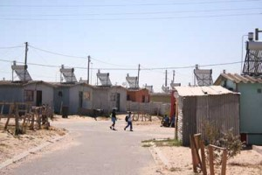
Financing the upgrade of low cost housing to include energy efficiency
Description of NAMA | Financing the inclusion of solar water heaters and thermal efficiency measures in one million new-build low-income houses by 2020
GHG reductions from baseline (MtCO₂eq) | Annual | 2011-2020 | 2011-2030
 | 3Mt | 30Mt | 95Mt
International support sought | Development of fund, programme and institutional capacity: €1m Capital costs of interventions: US$2.8 billion
Indicators to track implementation of action | Number of new-build houses including upgrades Number of low-income housing solar water heaters remaining in operation in 2020/30
Information which would add value | Significant health, safety and energy service delivery co-benefits through delivering improved quality housing to poor households Education and awareness-raising around clean energy issues in a sector of the population anticipated to drive emissions growth into the future Currently in advanced design phase, led by the Development Bank of Southern Africa

Slide 10

Related work on NAMA’s
Technical Analysis of NAMA’s at Cancun
Mitigation Action Plans & Scenarios (MAPS) programme
  Mitigation actions in Latin American countries
  SA case study on approach to mitigation actions
    Bottom up/existing initiatives
TERI project
http://www.mapsprogramme.org/about/

Slide 11
Unpacking the NAMA concept
Definitional issues
How to compare/assess co-benefits/ SD vs. tCO₂?
What will MRV look like?
What will the Registry look like?
Difference to CDM?
How to make it nationally appropriate?

Slide 12
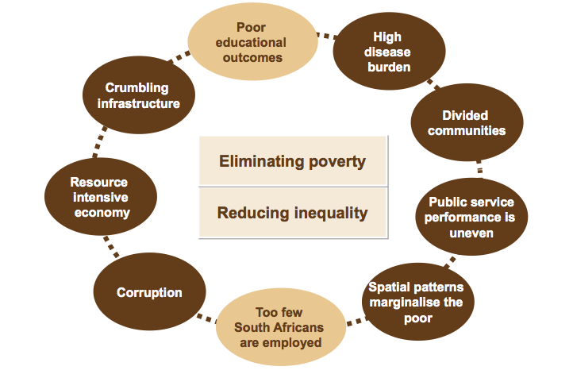
Key Strategic Objectives
NPC Diagnostic Report 2011

Slide 13
Implementation issues
  Alignment to national priorities
  Potential conflict of interest
Institutions & capacity to identify, design (modeling), implement & operationalise
Domestic & international components
Ownership and mandate
Project specific blockages
Indicators for tracking implementation

Slide 14
NAMA focus
Sustainable development
Add development implications
  Poverty component
  Co-benefits
Implementation strategies
  Moving identified actions into projects
    Crediting NAMA’s not focus
    More clarity of NAMA
Learn from partners on approaches

Slide 15
Thank you

Slide 16
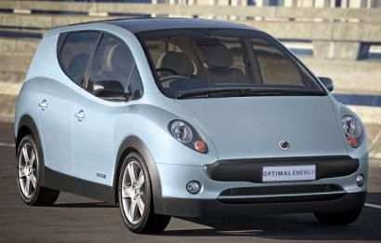
Rollout of electric private passenger vehicles in South Africa
Description of NAMA | Production and use of private passenger electric vehicles 10% penetration of electric private passenger vehicles by 2015, increasing to 27% in 2020, 60% expected by 2030
GHG reductions from baseline (MtCO₂ eq) | 2011-2020 | 2011-2030 | 2011-2050
 | 10.6 Mt | 92.3 Mt | 450.0 Mt
International support sought | Funding to cover incremental costs of US$344.7 billion from 2011-2050 to manufacture electric vehicles. It excludes costs for infrastructural reform. Technical support in establishing battery charging stations and battery swapping facilities.
Indicators to track implementation of action | Sales of electric vehicles to assess take-up by consumers. Sales of petrol and diesel vehicles Sales volumes of petrol and diesel-displacement of vehicles that use these fuels.
Information which would add value | Prototypes of wholly South African-designed electric vehicle models have been developed SA’s Council for Scientific and Industrial Research has extensively researched lithium batteries; current studies are evaluating feasibility of developing and producing batteries locally Sustainable development benefits of the NAMA include lower local air pollution, employment creation and potential balance of payment benefits.

Slide 17
Rollout of electric private passenger vehicles in South Africa
Description of NAMA | Production and use of private passenger electric vehicles 10% penetration of electric private passenger vehicles by 2015, increasing to 27% in 2020, 60% expected by 2030
GHG reductions from baseline (MtCO₂ eq) | 2011-2020 | 2011-2030 | 2011-2050
 | 10.6 Mt | 92.3 Mt | 450.0 Mt
International support sought | Funding to cover incremental costs of US$344.7 billion from 2011-2050 to manufacture electric vehicles. It excludes costs for infrastructural reform. Technical support in establishing battery charging stations and battery swapping facilities.
Indicators to track implementation of action | Sales of electric vehicles to assess take-up by consumers. Sales of petrol and diesel vehicles Sales volumes of petrol and diesel-displacement of vehicles that use these fuels.
Information which would add value | Prototypes of wholly South African-designed electric vehicle models have been developed SA’s Council for Scientific and Industrial Research has extensively researched lithium batteries; current studies are evaluating feasibility of developing and producing batteries locally Sustainable development benefits of the NAMA include lower local air pollution, employment creation and potential balance of payment benefits.

Slide 18
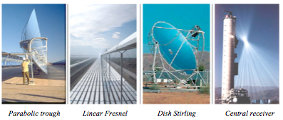
Incremental funding of 5GW of CSP up to 2020
Description of NAMA | Two phases: Prepare (2010-2012) and rollout (2013-2020) First plants coming into operation from 2015 and 5GW capacity online by 2020 Incorporate plan into IRP, conclude IPP/solar park regulatory framework and establish funding mechanism
GHG reductions from baseline (MtCO₂eq) | 2011-2020 | 2011-2030 | 2011-2050
 | 232 Mt | 663 Mt | 1518 Mt
International support sought | Finance – $2 billion by 2020 as grant / concessional loan to the REFIT or Solar Park Technology – initially parabolic trough, then CSP central receiver and dish designs. Water saving technology will become important Capacity – REFIT & independent systems operator capacity support required
Indicators to track implementation of action | Establishment of funding mechanisms - institutional Finance disbursed to utilities in CSP programme Capacity of CSP installed through programme Electricity produced from funded CSP installations
Information which would add value | Pioneering RE in electricity system, developing industrial capacity in CSP as a basis for further expansion Incremental employment benefits, especially with localisation Regional development, local air pollution benefits

